Slide 1
Relationship of NNPWG to SNPWG

Slide 2
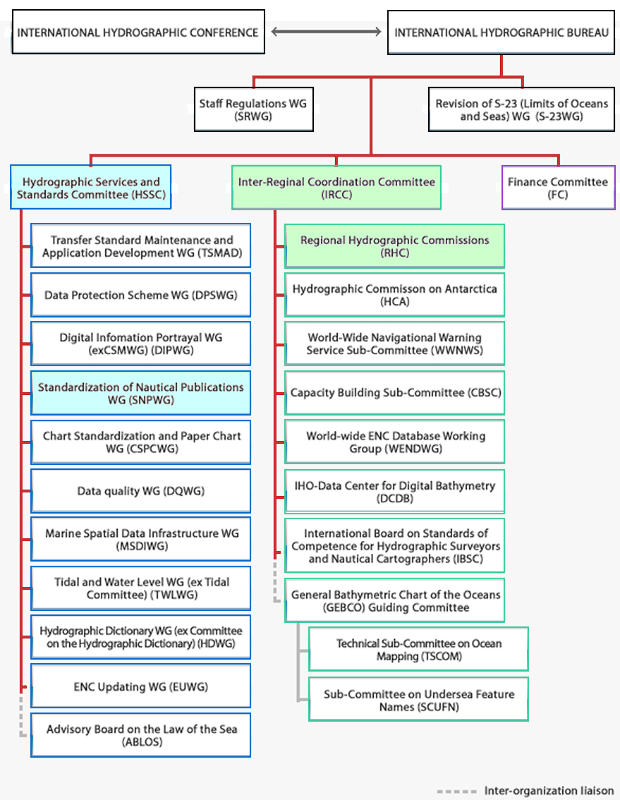
Authothority
International Hydrographic Organization

Slide 3
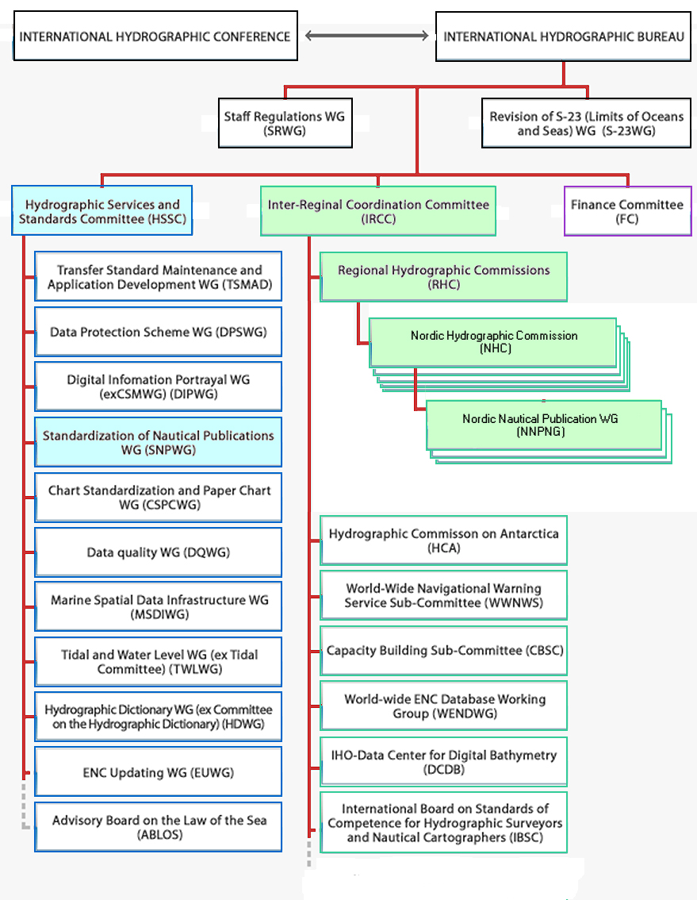
Authothority
International Hydrographic Organization

Slide 4
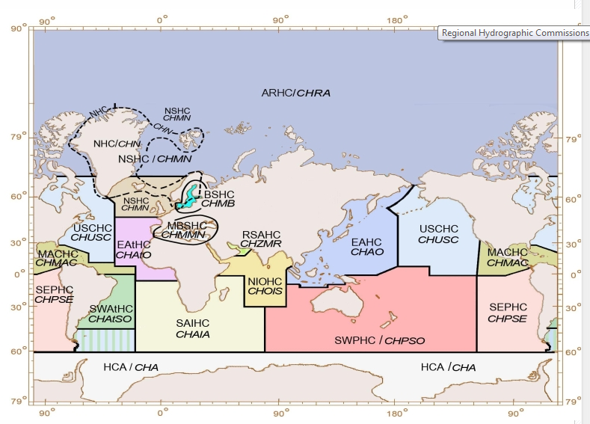
Regional Hydrographic Commissions (RHC)

Slide 5
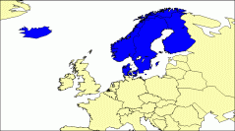
Nordic Hydrographic Commission (NHC)
The Nordic Hydrographic Commission (NHC) was formally established in Stockholm, Sweden on 18 March 1929, at a meeting of the Hydrographers of Denmark, Finland, Norway and Sweden. The creation of the NHC had already been proposed at a meeting in 1926. The first Chairman of the NHC was Commander Gustaf Reinius (Sweden). Iceland joined the Commission in 1956. The first activities included discussions on the standardization of chart symbols, water level information on charts, copyright of nautical publications, implementation of the recommendations of IHB Conferences, and reducing the costs of the IHB without reducing its efficiency. The main achievements have been changing opinions, providing information, harmonizing Nordic practices with regard to various hydrographic related issues and jointly contributing to the IHO work.

Slide 6
Nordic Nautical Publication Work Group (NNPWG) Establishment
16th BSHC Conference Agenda item E
Norrköping, Sweden Explanatory Note
19-21 September 2011 Denmark
The establishment of a Nordic Nautical Publication WG
Introduction
This explanatory note includes a presentation of status and initiatives related to
publications in the Nordic Hydrographic Commission and an invitation for the Baltic
member states to participate in the forthcoming work in a newly established Nordic
Nautical Publication WG (NNPWG).
. . . . . .
The Working Group should:
• Primarily focus on issues related to printed nautical publications (NP1) and to
corresponding digital copies (NP2).
• If deemed appropriate and time permits also focus on NP3 and the co-operation
with SNPWG. In order to discuss which of NP information should be included in
the ECDIS and to agree on standards from a regional perspective.
. . . . . .
Link to this document

Slide 7
Highlights of ToRs
SNWPG |  | NNWPG
To develop guidelines for the preparation of nautical publications, in a digital format compatible with ECDIS. The WG should: (i) Investigate the data format specifications, content and display requirements of digital nautical publications intended for use in ECDIS. (ii) Draft guidance document(s) and/or revised technical resolutions, as appropriate. (iii) Liaise with relevant IHO Technical WG’s to ensure, technical feasibility and compatibility of any developed proposals. ata format specifications, content and display requirements of digital nautical publications intended for use in ECDIS. Link to Tor |  | The Nordic Hydrographic Commission (NHC) recognizes the need to manage and distribute information/data for improved and future Nautical Publications or the equivalent in various formats. The Nordic Nautical Publications WG shall: a) Support the work of the IHO SNPWG. b) Investigate relevant use cases regarding use of nautical publication (NP) information. c) Suggest ways to present and distribute various NP products. d) Create guidelines for an HO to efficiently manage NP data supporting a multitude of NP products. Link to Tor

Slide 8
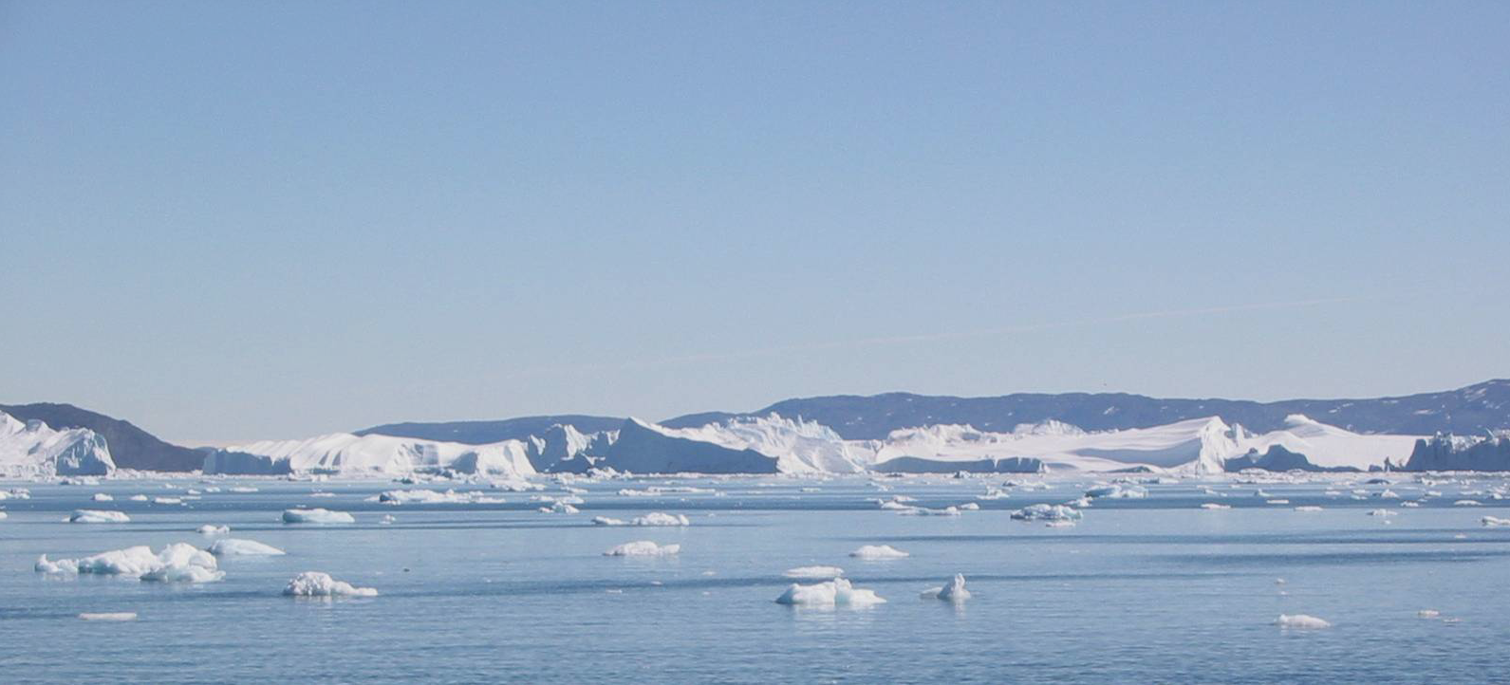
Rostock-meeting 13th-14th Dec 2011 (participants from NSHC, BSHC & ARHC)
Workshop
The future of nautical publications
Tuesday and Wednesday
December 13th and 14th
BSH - Rostock - Germany

Slide 9
Agenda

Slide 10
The goals and objectives of the workshop
Learn to know your colleagues better
Exchange knowledge and insights
Create a framework for future cooperation regarding nautical publications
Investigate the possibility of closer cooperation
Sharpen our awareness of the development of publications, including the possibility of joint exchange of practical and/or operational solutions
Create a framework for discussing priorities
Agree on a way to proceed

Slide 11
The goals and objectives of the workshop
After this workshop:
Gained insight into the status of other countries’ nautical publications
Gathered information about the current situation and discussed how to proceed
Established a forum for exchanging and sharing knowledge and technical solutions
Agreed on how to proceed

Slide 12
Nordic Nautical Publications WG
At the NHC conference in 2010, the need for establishing a Nordic Nautical
Publication Working Group as a formal working group was discussed.
One important issue was to clarify if the SNPWG would solve our challenges concerning publications in the future and thus make a regional WG redundant.
It was stated that:
• the aim of SNPWG is to develop guidelines for the preparation of nautical publications, in a digital format compatible with ECDIS.
• SNPWG will not provide guidelines for nautical publications in paper/printed version, nor the future content of nautical publications.
• A coordinated Nordic effort with regards to nautical publications does therefore not conflict or overlap with the scope of SNPWG.

Slide 13
Extact from ToR for NNPWG
The Working Group should:
• Primarily focus on issues related to printed nautical publications (NP1) and to corresponding digital copies (NP2).
• If deemed appropriate and time permits also focus on NP3 and the co-operation with SNPWG. In order to discuss which of NP information should be included in the ECDIS and to agree on
• To forward its findings and recommendations for NP1s and NP2s which may have importance to the SNPWG for further evaluation

Slide 14

Workshop Summary and Results

Slide 15

Straight and open discussion
NNPWG SNPWG

